Slide 1


Shiva Shankar D S
24/02/2025

Slide 2

Outline
Executive Summary
Introduction
Methodology
Results
Conclusion
Appendix

Slide 3
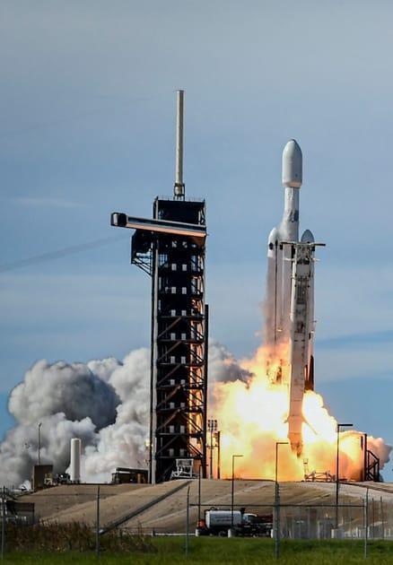
Executive Summary
Summary of Methodologies
The research attempts to identify the factors for a successful rocket landing. Our methodologies include:
Collect data using SpaceX REST API and web scraping techniques
Wrangle data to create success/fail outcome variable
Explore data with data visualization techniques, considering the following factors: payload, launch site, flight number and yearly trend
Analyze the data with SQL, calculating the following statistics: total payload, payload range for successful launches, and total of successful and failed outcomes
Explore launch site success rates and proximity to geographical markers
Visualize the launch sites with the most success and successful payload ranges
Build Models to predict landing outcomes using logistic regression, support vector
machine (SVM), decision tree and K-nearest neighbor (KNN)
Summary of Results
EDA:
Launch success has improved over time
KSC LC-39A has the highest success rate among landing sites
Orbits ES-L1, GEO, HEO, and SSO have a 100% success rate
Geographical Analysis (Folium):
Most launch sites are near the equator, and all are close to the coast.
Predictive Analysis:
All models performed similarly on the test set, i.e. accuracy of 83%.

Slide 4
Introduction
The advancements in space technology have significantly transformed the commercial space industry, with companies like SpaceX leading the way in cost-effective space
exploration. One of SpaceX’s key innovations is the reusability of the Falcon 9 first-
stage booster, which dramatically reduces the cost of space missions. A typical Falcon 9 launch costs $62 million, whereas other space launch providers charge over $165 million per launch. The ability to successfully land and reuse the first-stage booster is a crucial factor in these cost savings.
This capstone project focuses on predicting the successful landing of the Falcon 9 first stage. By developing a predictive model, we aim to assess the probability of a successful landing and explore its impact on launch costs. This information is particularly valuable for competing aerospace companies seeking to evaluate the feasibility of bidding against SpaceX for commercial satellite launches.

Slide 5

Section 1

Slide 6

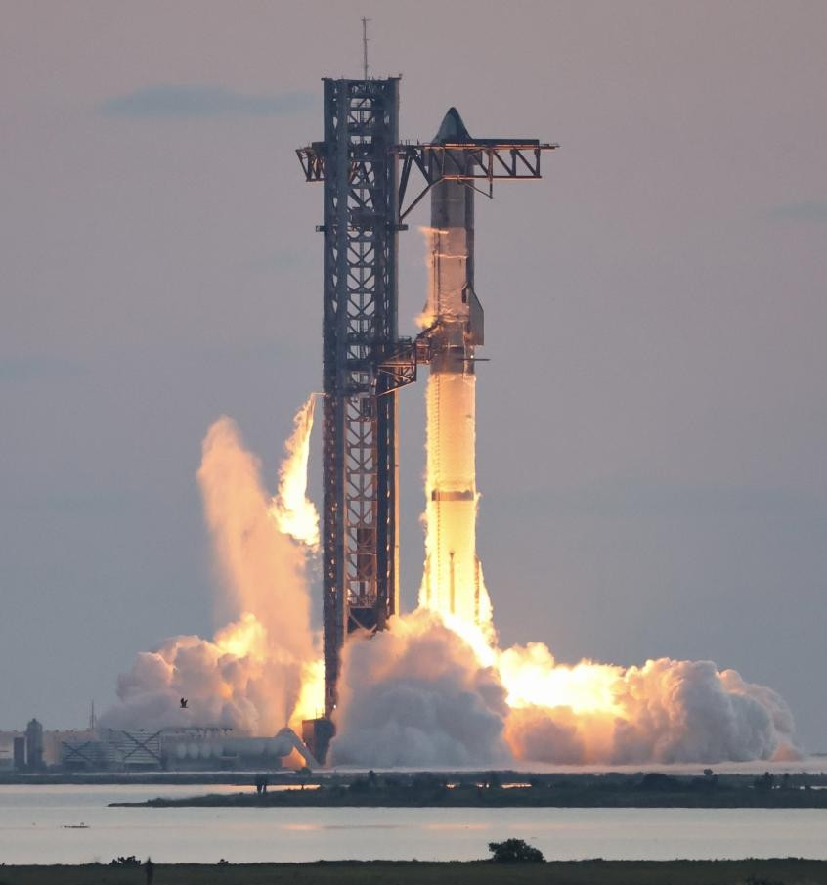
Methodology
Executive Summary
Data collection methodology: through SpaceX API
and web scrapping Wikipedia.
Perform data wrangling
Perform exploratory data analysis (EDA) using
visualization and SQL
Perform interactive visual analytics using Folium and Plotly Dash
Perform predictive analysis using classification models: Logistic Regression, SVM, KNN, and Decision Tree.

Slide 7
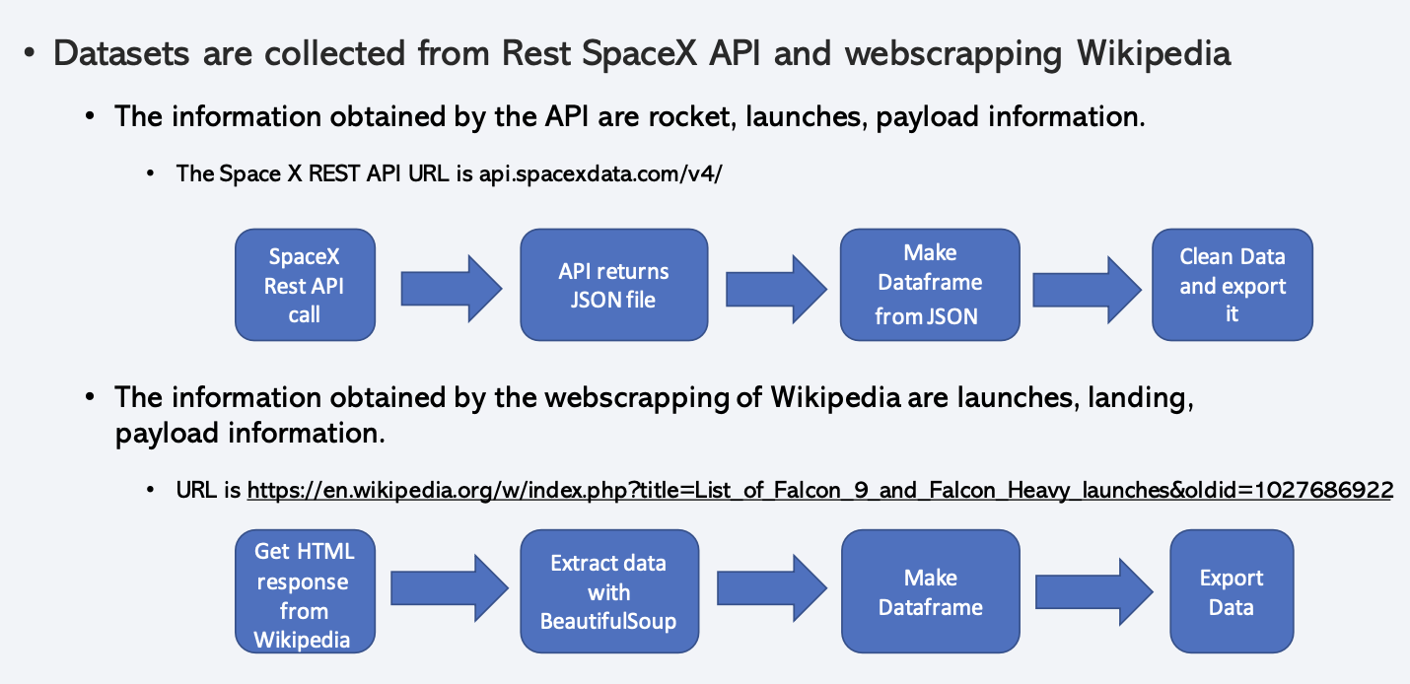
Data Collection

Slide 8
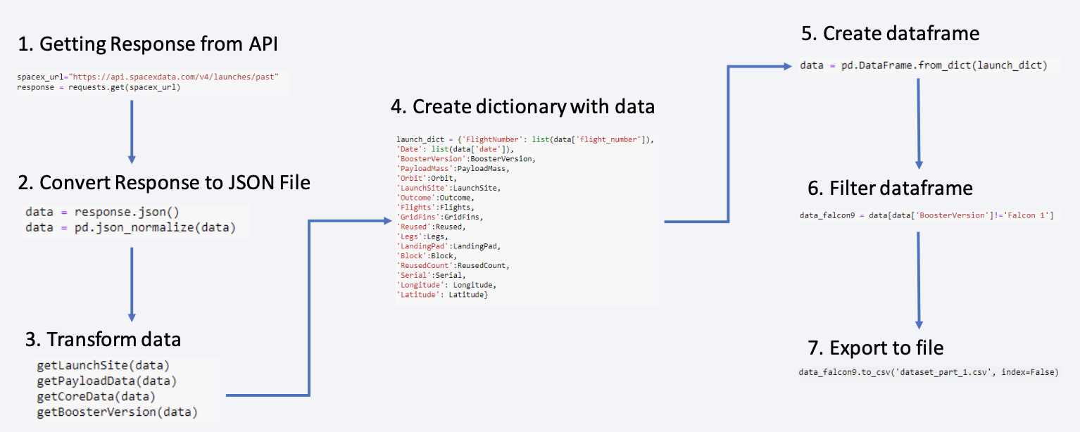
Data Collection – SpaceX API
The link to the notebook is
https://github.com/snc4shiva/Data-Science-Capstone-Project/blob/main/Lab%20-%20Data%20Collection%20API.ipynb

Slide 9
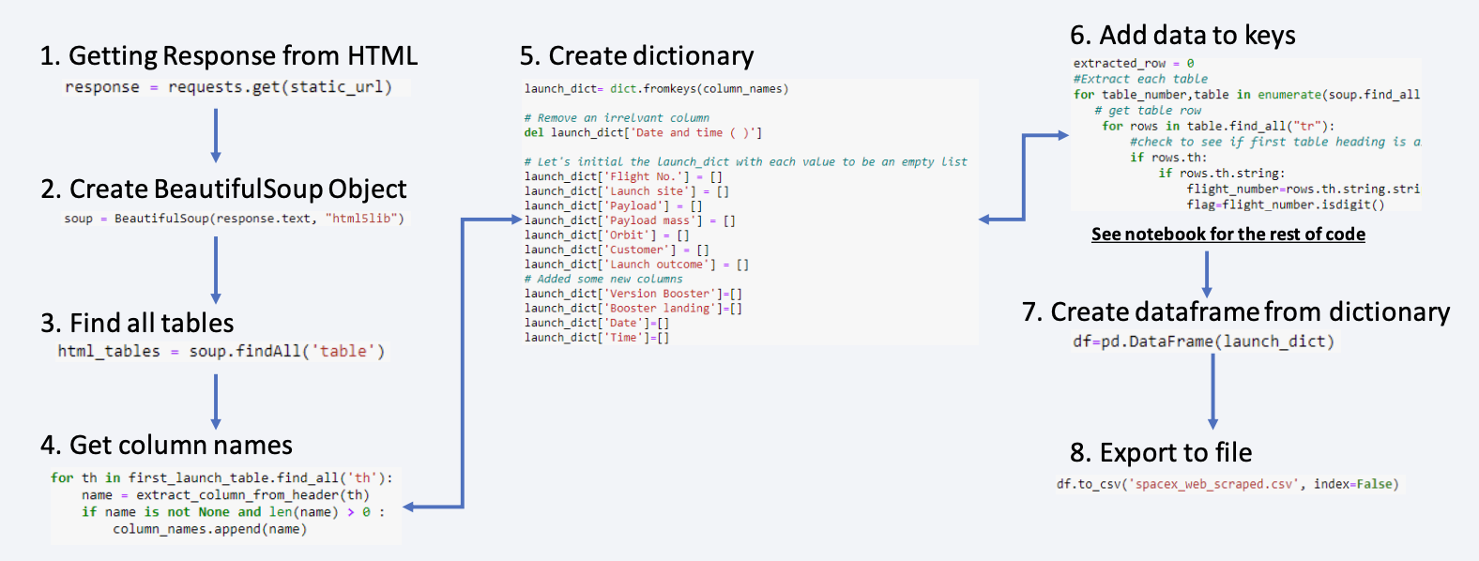
Data Collection - Scraping
The link to the notebook is
https://github.com/snc4shiva/Data-Science-Capstone-Project/blob/main/Lab%20-%20Data%20Collection%20with%20Web%20Scraping.ipynb

Slide 10
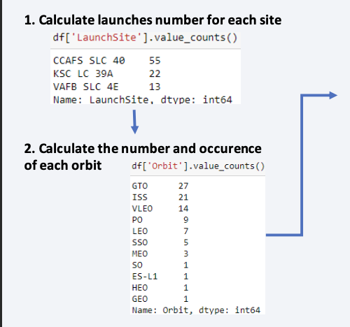
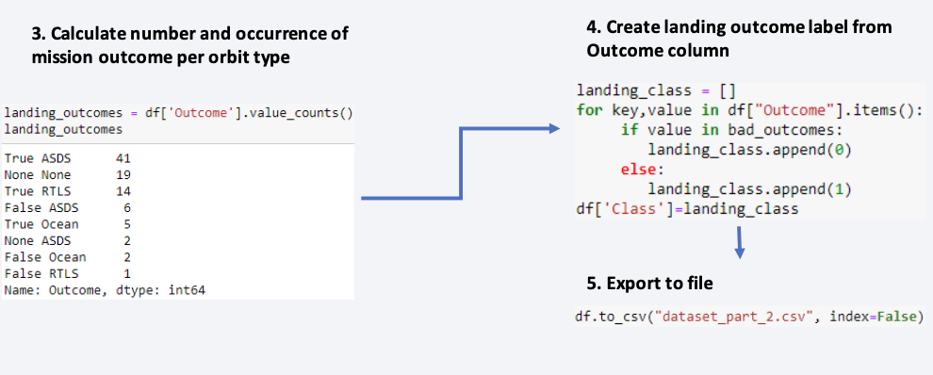
Data Wrangling
In the dataset, there are several cases where the booster did not land successfully.
True Ocean, True RTLS, and True ASDS mean the mission has been successful.
False Ocean, False RTLS, False ASDS means the mission was a failure.
We need to transform string variables into categorical variables where 1 means the mission has been successful and 0 means the mission was a failure.
The link to the notebook is
https://github.com/snc4shiva/Data-Science-Capstone-Project/blob/main/Lab%20-%20Data%20Wrangling.ipynb

Slide 11


EDA with Data Visualization
We explored the data by visualizing the relationship between flight number and launch Site, payload and launch site, the success rate of each orbit type, flight number, and orbit type, and the launch success yearly trend.
The Link to the notebook is
https://github.com/snc4shiva/Data-Science-Capstone-Project/blob/main/Lab%20-%20EDA%20with%20Visualization.ipynb

Slide 12
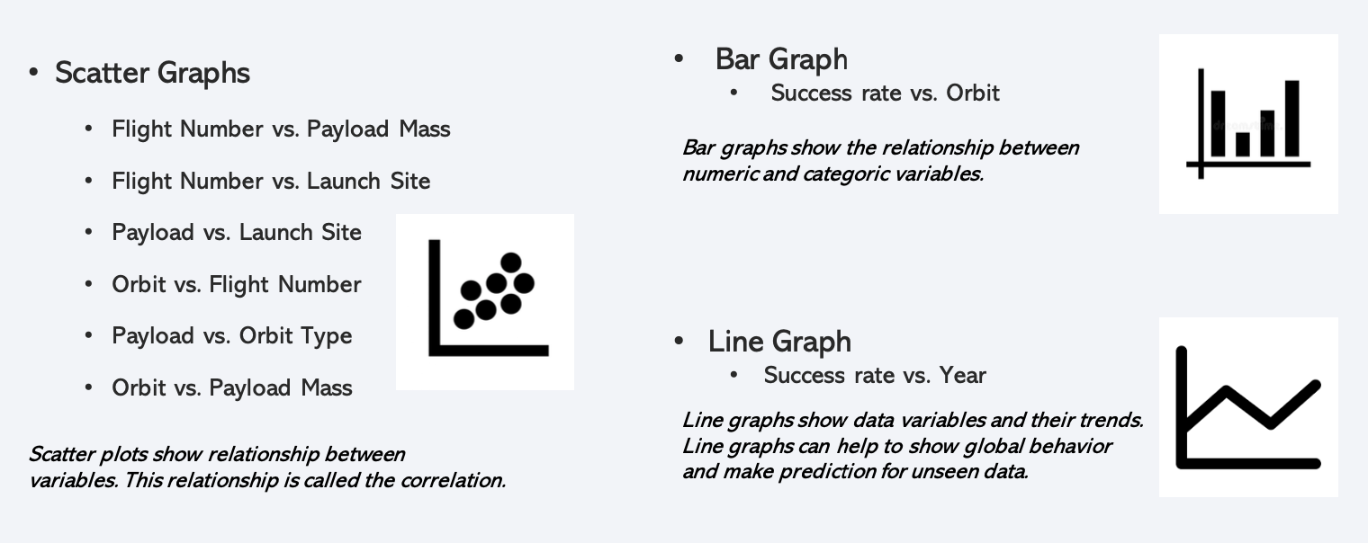
EDA with Data Visualization

Slide 13
EDA with SQL
We loaded the SpaceX dataset into a PostgreSQL database without leaving the jupyter notebook.
We applied EDA with SQL to get insight from the data. We wrote queries to find out for instance:
- The names of the unique launch sites in the space mission.
- The total payload mass carried by boosters launched by NASA (CRS)
- The average payload mass carried by booster version F9 v1.1
- The total number of successful and failed mission outcomes
- The failed landing outcomes in drone ship, their booster version, and launch site names.
The link to the notebook is
https://github.com/snc4shiva/Data-Science-Capstone-Project/blob/main/Lab%20-%20EDA%20with%20SQL.ipynb

Slide 14
Build an Interactive Map with Folium
We marked all launch sites and added map objects such as markers, circles, and lines to mark the success or failure of launches for each site on the folium map.
We assigned the feature launch outcomes (failure or success) to class 0 and 1. i.e., 0 for failure, and 1 for success.
Using the color-labeled marker clusters, we identified which launch sites have relatively high success rates.
We calculated the distances between a launch site to its proximities. We answered some questions for instance:
- Are launch sites near railways, highways, and coastlines.
- Do launch sites keep a certain distance away from cities?
The link to the notebook is
https://github.com/snc4shiva/Data-Science-Capstone-Project/blob/main/06_SpaceX_Interactive_Visual_Analytics_Folium.ipynb

Slide 15
Build a Dashboard with Plotly Dash
We built an interactive dashboard with Plotly dash.
We plotted pie charts showing the total launches by certain sites.
We plotted a scatter graph showing the relationship between Outcome and Payload Mass (Kg) for the different booster versions.
The link to the notebook is
https://github.com/snc4shiva/Data-Science-Capstone-Project/blob/main/SpaceX_Interactive_Visual_Analytics_Plotly.py

Slide 16
Predictive Analysis (Classification)
We loaded the data using NumPy and pandas, transformed the data, and split our data into training and testing.
We built different machine-learning models and tuned different hyperparameters using GridSearchCV.
We used accuracy as the metric for our model and improved the model using feature engineering and algorithm tuning.
We found the best-performing classification model.
The link to the notebook is
https://github.com/snc4shiva/Data-Science-Capstone-Project/blob/main/08_SpaceX_Predictive_Analytics.ipynb

Slide 17
Results
Exploratory data analysis results
Interactive analytics demo in screenshots
Predictive analysis results

Slide 18

Section 2

Slide 19
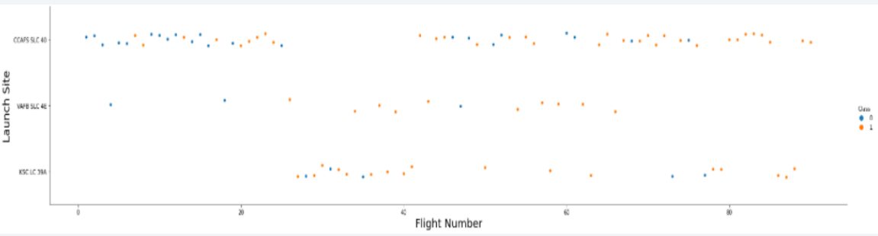
Flight Number vs. Launch Site
Earlier flights had a lower success rate (blue = fail)
Later flights had a higher success rate (orange = success)
Around half of the launches were from the CCAFS SLC 40 launch site
VAFB SLC 4E and KSC LC 39A have higher success rates
We can infer that new launches have a higher success rate

Slide 20
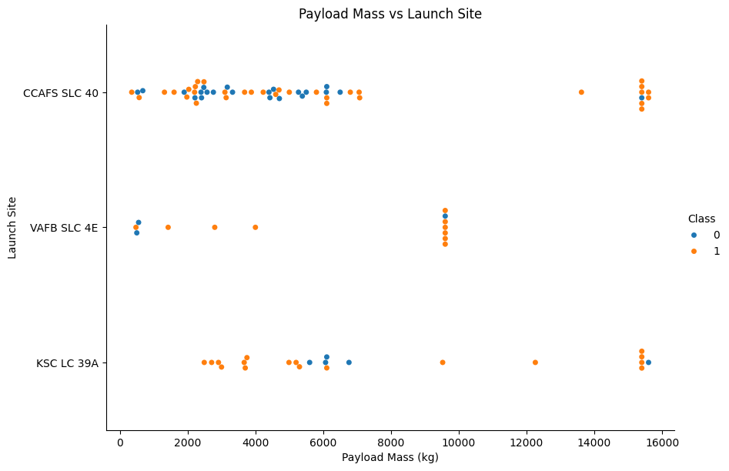
Payload vs. Launch Site
Typically, the higher the payload mass (kg), the higher the success rate
Most launces with a payload greater than 7,000 kg were successful
KSC LC 39A has a 100% success rate for launches less than 5,500 kg
VAFB SKC 4E has not launched anything greater than ~10,000 kg

Slide 21
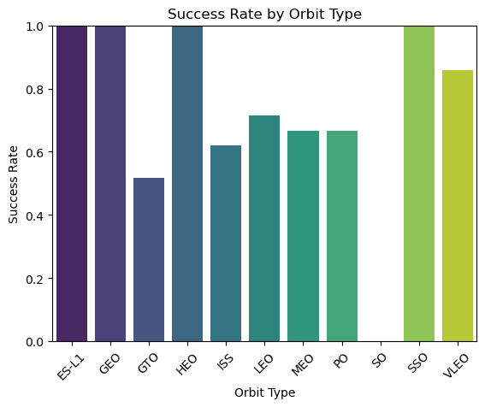
Success Rate vs. Orbit Type
From the plot, we can see that ES-L1, GEO, HEO, SSO, VLEO had the most success rate.

Slide 22
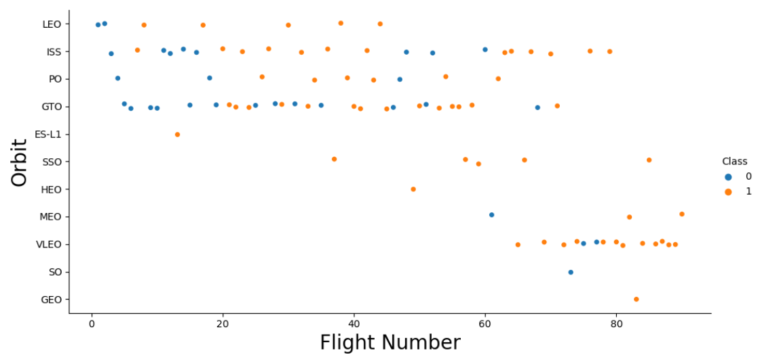
Flight Number vs. Orbit Type
The plot below shows the Flight Number vs. Orbit type. We observe that in the LEO orbit, success is related to the number of flights whereas in the GTO orbit, there is no relationship between flight number and the orbit.

Slide 23
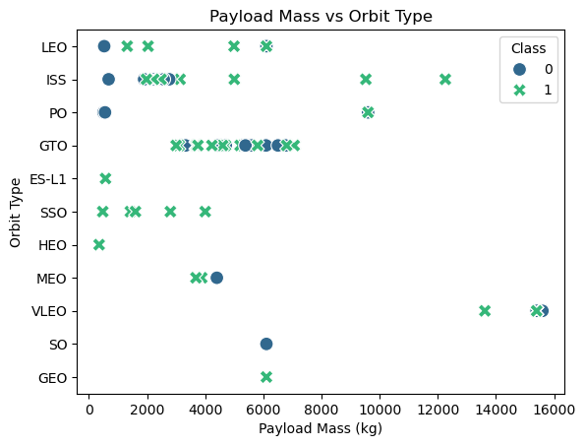
Payload vs. Orbit Type
We can observe that with heavy payloads, the successful landing are more for PO, LEO and ISS orbits.

Slide 24
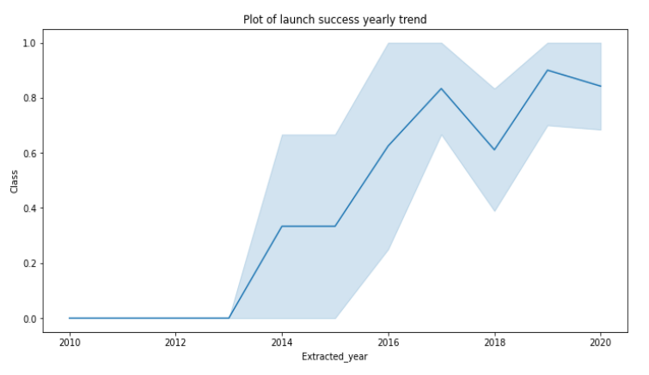
Launch Success Yearly Trend
The success rate improved from 2013-2017 and 2018-2019
The success rate decreased from 2017-2018 and 2019-2020
Overall, the success rate has improved since 2013

Slide 25
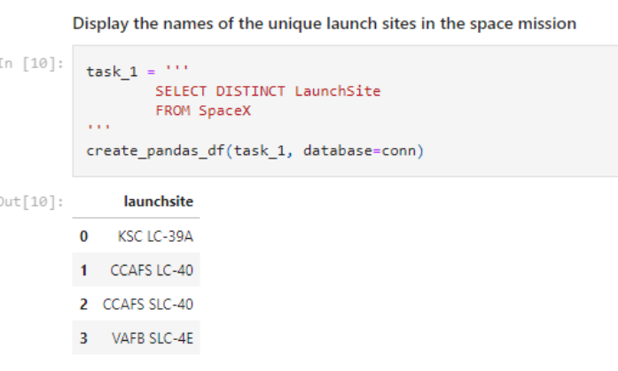
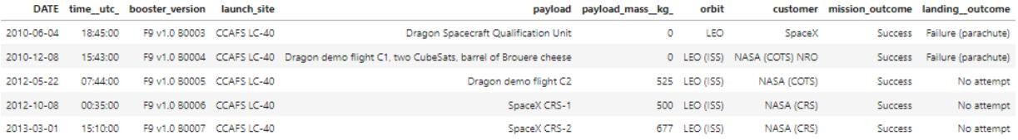
All Launch Site Names
We used the key word DISTINCT to show only unique launch sites from the SpaceX data.
The table below shows the 5 records from the launch site CCAFS LC-40.

Slide 26
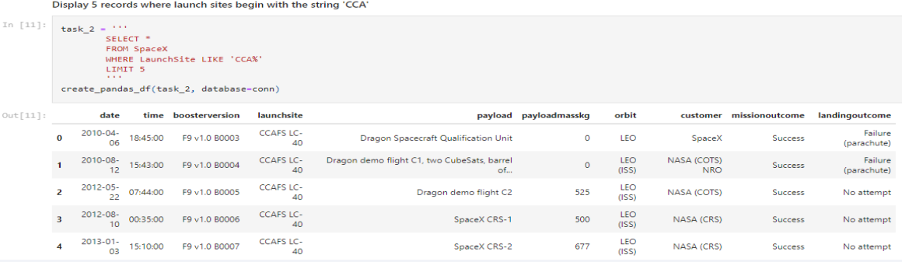
Launch Site Names Begin with 'CCA'
We used the query above to display 5 records where launch sites begin with `CCA`

Slide 27
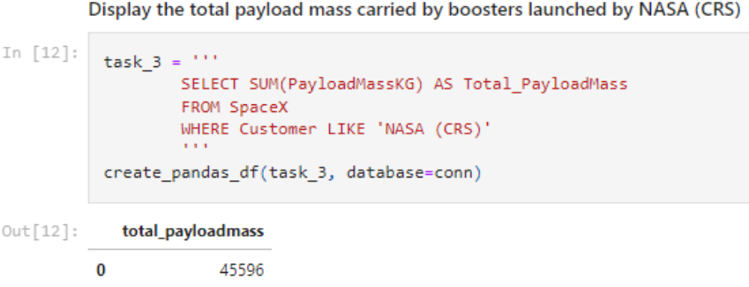
Total Payload Mass
We calculated the total payload carried by boosters from NASA as 45596 using the query below.

Slide 28
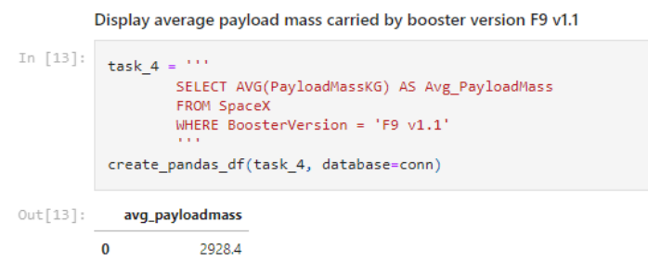
Average Payload Mass by F9 v1.1
We calculated the average payload mass carried by booster version F9 v1.1 as 2928.4

Slide 29
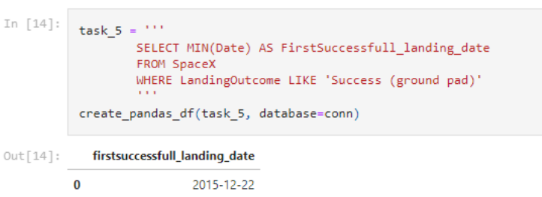
First Successful Ground Landing Date
We observed that the dates of the first successful landing outcome on ground pad was 22nd December 2015

Slide 30
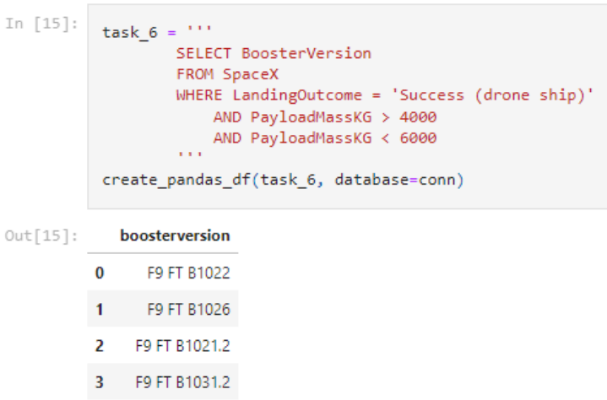
Successful Drone Ship Landing with Payload between 4000 and 6000
We used the WHERE clause to filter for boosters that have successfully landed on a drone ship and applied the AND condition to determine successful landing with payload mass greater than 4000 but less than 6000

Slide 31

Total Number of Successful and Failure Mission Outcomes
We used wildcards like ‘%’ to filter for WHERE MissionOutcome was a success or a failure.

Slide 32
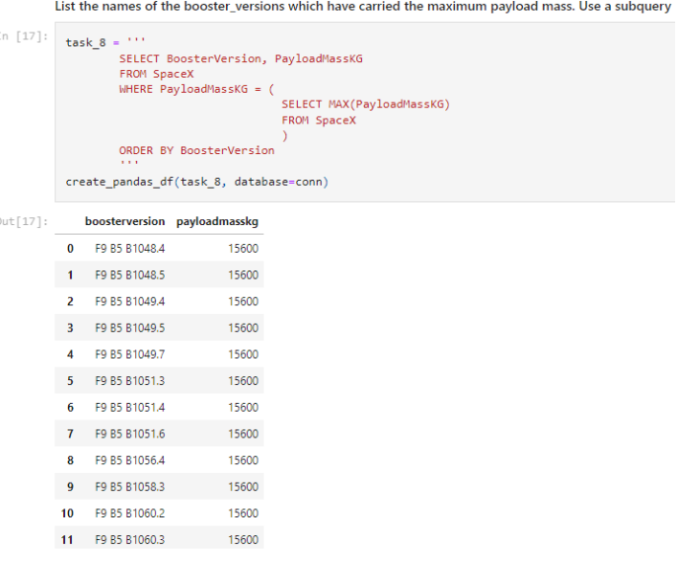
Boosters Carried Maximum Payload
We determined the booster that has carried the maximum payload using a subquery in the WHERE clause and the MAX() function.

Slide 33
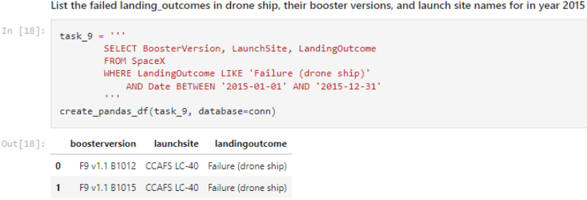
2015 Launch Records
We used a combination of the WHERE clause, LIKE, AND, and BETWEEN conditions to filter for failed landing outcomes in drone ships, their booster versions, and launch site names for the year 2015

Slide 34
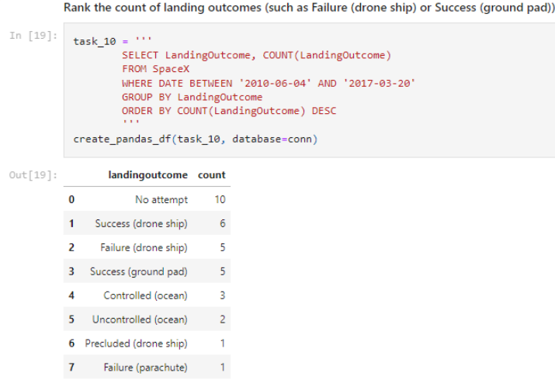
Rank Landing Outcomes Between 2010-06-04 and 2017-03-20
We selected Landing outcomes and the COUNT of landing outcomes from the data and used the WHERE clause to filter for landing outcomes BETWEEN 2010-06-04 to 2010-03-20.
We applied the GROUP BY clause to group the landing outcomes and the ORDER BY clause to order the grouped landing outcomes in descending order.

Slide 35

Section 3

Slide 36
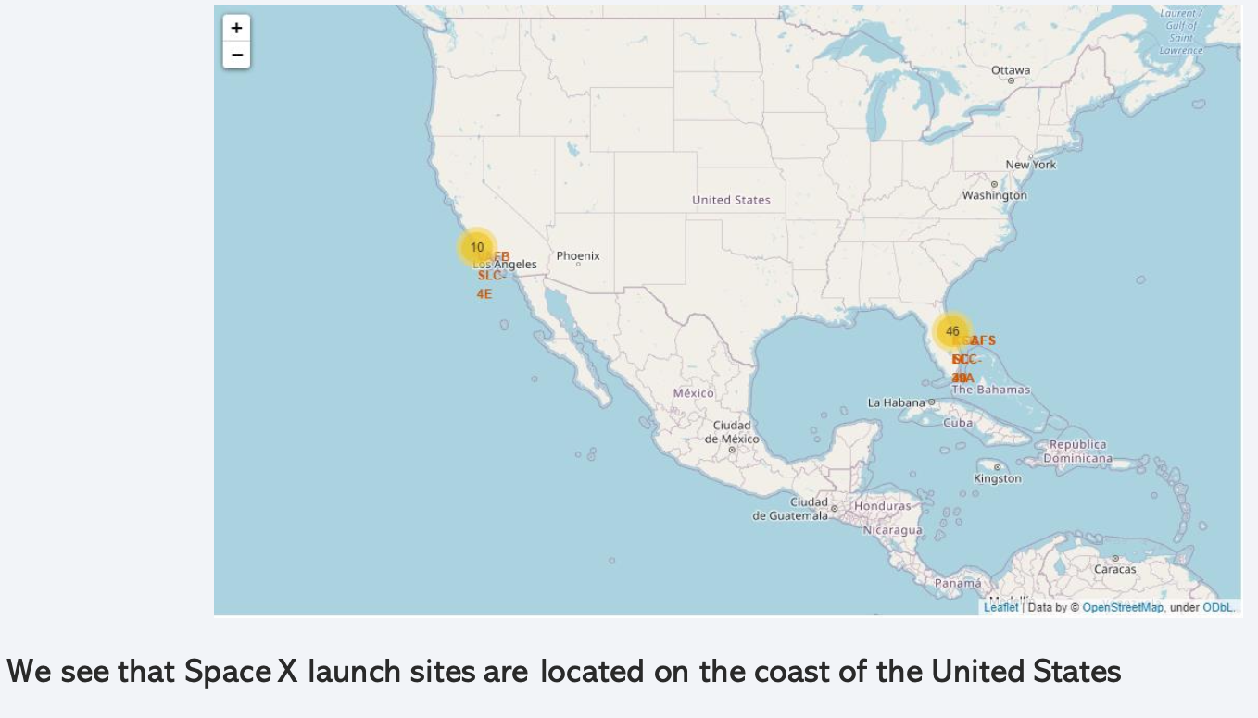
Folium map – Ground stations

Slide 37
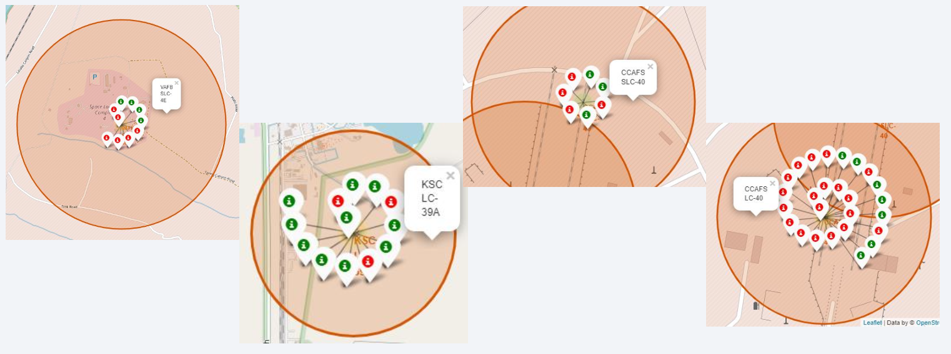
Folium map – Color Labeled Markers
The green marker represents successful launches. The Red marker represents unsuccessful launches.
We note that KSC LC-39A has a higher launch success rate.

Slide 38
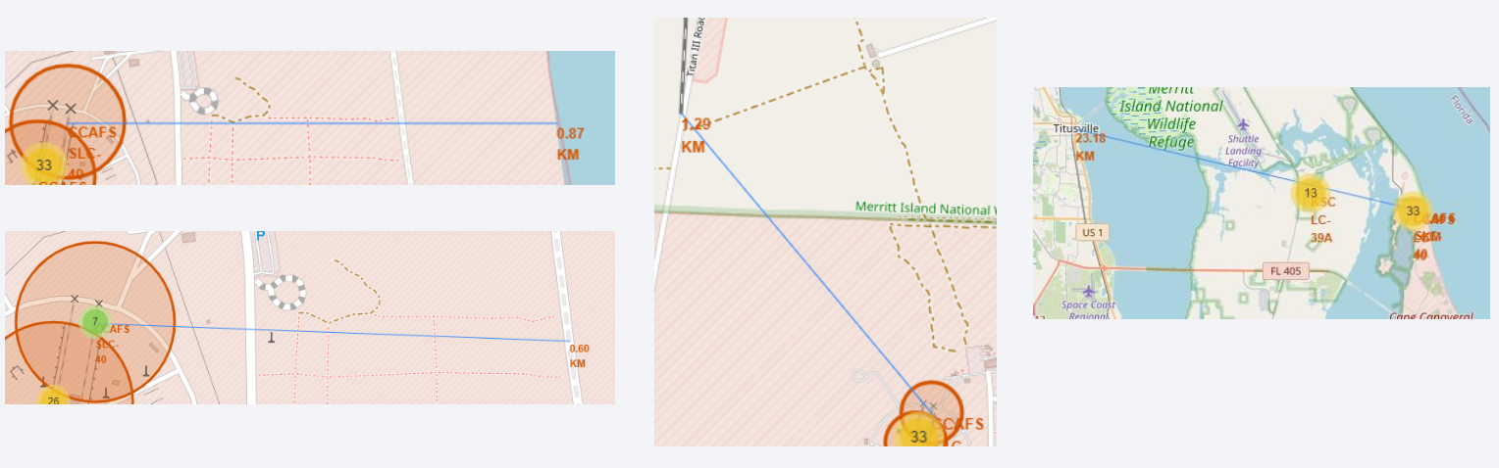
Folium Map – Distances between CCAFS SLC-40 and its proximities
Is CCAFS SLC-40 in close proximity to railways ? Yes
Is CCAFS SLC-40 in close proximity to highways ? Yes
Is CCAFS SLC-40 in close proximity to coastline ? Yes
Do CCAFS SLC-40 keeps certain distance away from cities ? No

Slide 39

Section 4

Slide 40
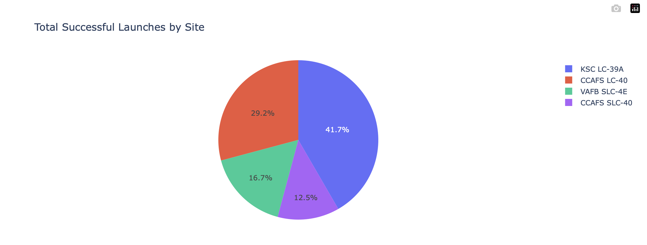
Total success by Site
We see that KSC LC-39A has the best success rate of launches.

Slide 41
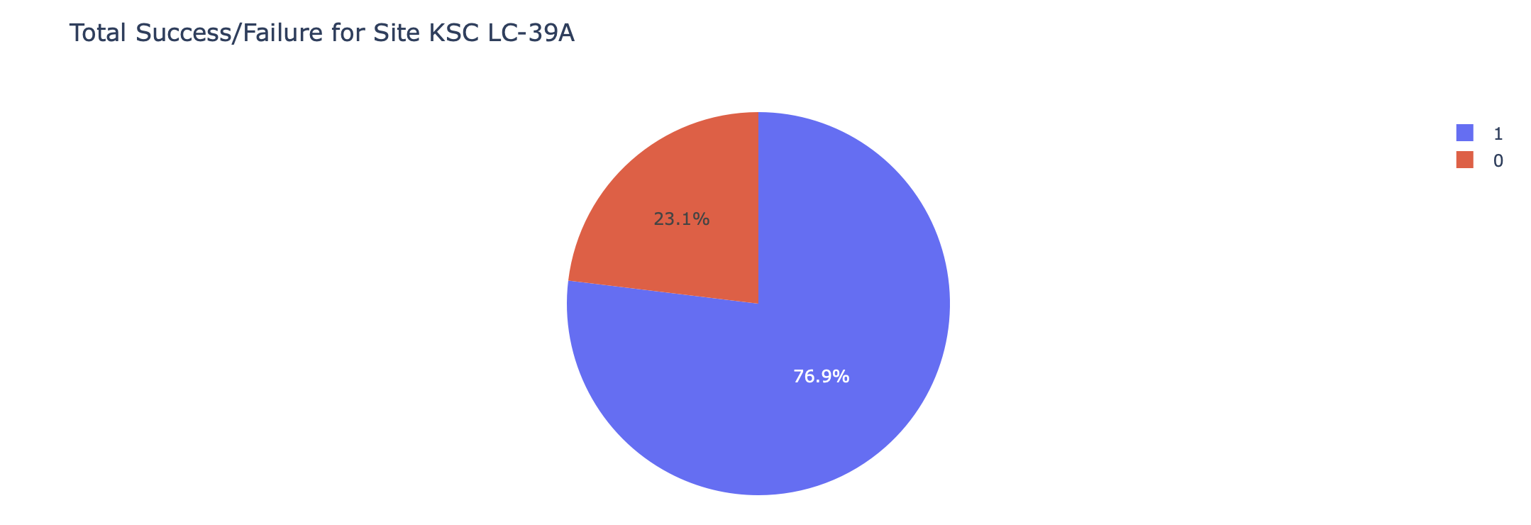
Pie chart showing the Launch site with the highest launch success ratio
We see that KSC LC-39A has achieved a 76.9% success rate while getting a 23.1% failure rate.

Slide 42
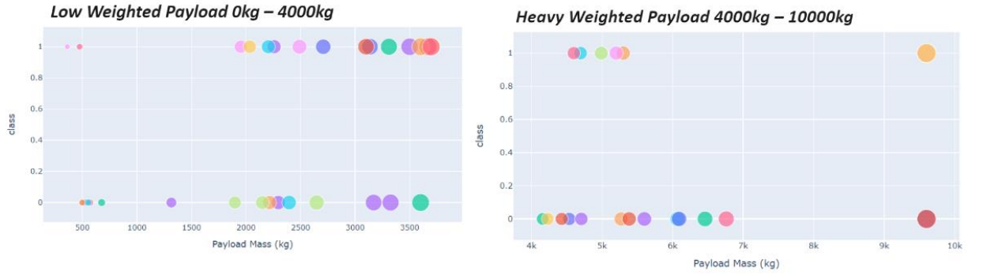
Scatter plot of Payload vs Launch Outcome for all sites, with different payload selected in the range slider
We can see success rate for low-weighted payloads is higher than the heavy-weighted payloads.

Slide 43

Section 5

Slide 44
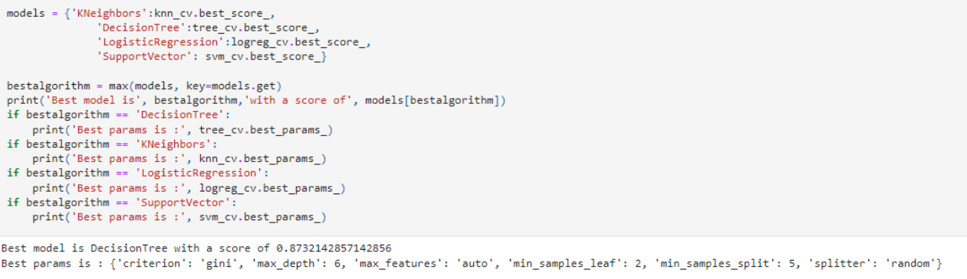
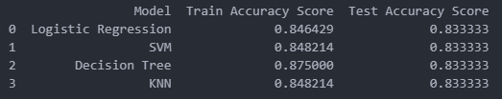
Classification Accuracy
The decision tree classifier is the model with the highest classification accuracy.

Slide 45
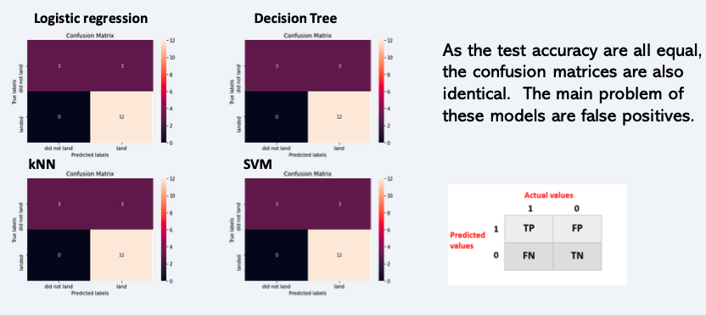
Confusion Matrix

Slide 46
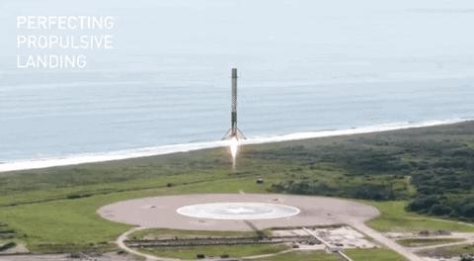
Conclusions
Any of these models can be used for prediction, but simpler models like Logistic Regression or SVM might be preferred due to their interpretability and robustness.
Decision Tree has the highest training accuracy but does not generalize better than the others.
If needed, further hyperparameter tuning or trying ensemble methods (like Random Forest) might improve performance

Slide 47


